Slide 1


Adoption and Usage of Chaterly at ABC Corp. Data source: Database admin team at Chaterly Time frame: May 2017 – April 2018 David Rubio, Estelle Eteki, Johannes Glatz, Rishabh Prakash, Yi Jin Chaterly HQ, San Francisco 05/01/2018

Slide 2




Business Context
Goal
Identify adoption, usage patterns, and upsell opportunities for ABC Corp.
Definition
Adopters: ABC employees that registered to Chaterly.
Early Adopters: ABC employees that registered and used Chaterly in the first 2 months.
Active Users: ABC employees that posted in the last 30 days.
Power Users: top 12% of users who generate 50% of content.
Caveats
ABC Corp. is Chaterly’s flagship customer.
The data time period is May 2017 to April 2018.
The dataset is provided by Chaterly’s database admin team.

Slide 3


Executive Summary
Adoption and Usage Patterns
Upsell Opportunities
101,000 out of 208,000 total employees have posted on Chaterly.
Early adopters (May – June 2017), used Chaterly 6x more than others.
Users that post within first 5 days after registration post 13x more in total.
12% of users generated 50% of the total posts (Power Users).
105% possible additional users. a
Incentivize early adoption to improve user interaction.
Incentivize quick activation to drive engagement.
Roll out Chaterly Pro to Active and Power Users.

Slide 4
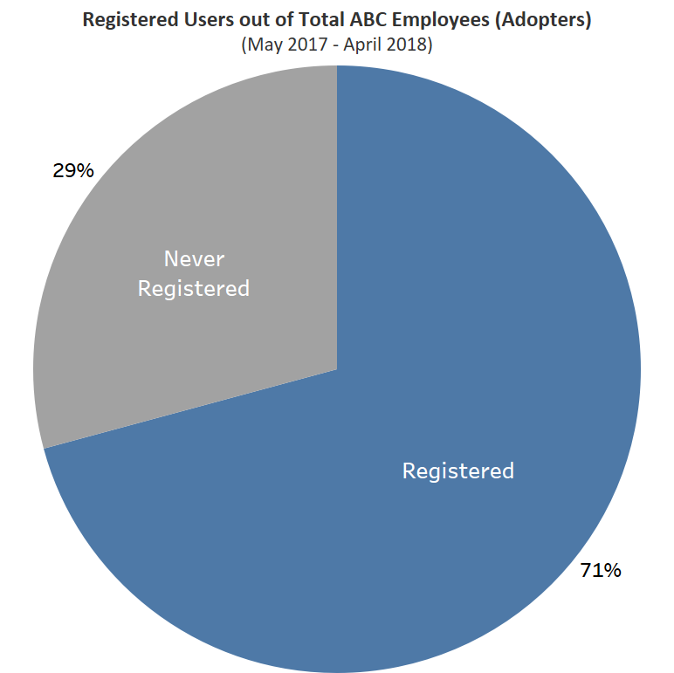
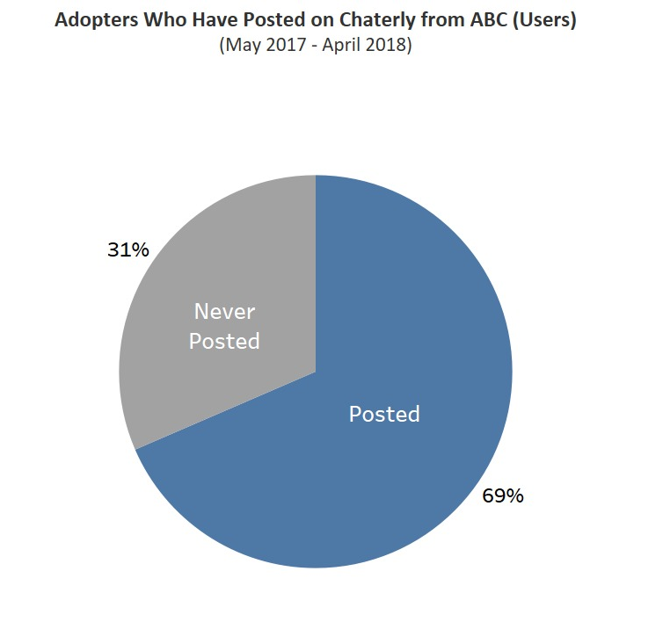
Adoption of Chaterly 101,000 (49%) ABC employees have adopted and used Chaterly at least once
Out of Registered Users

Slide 5
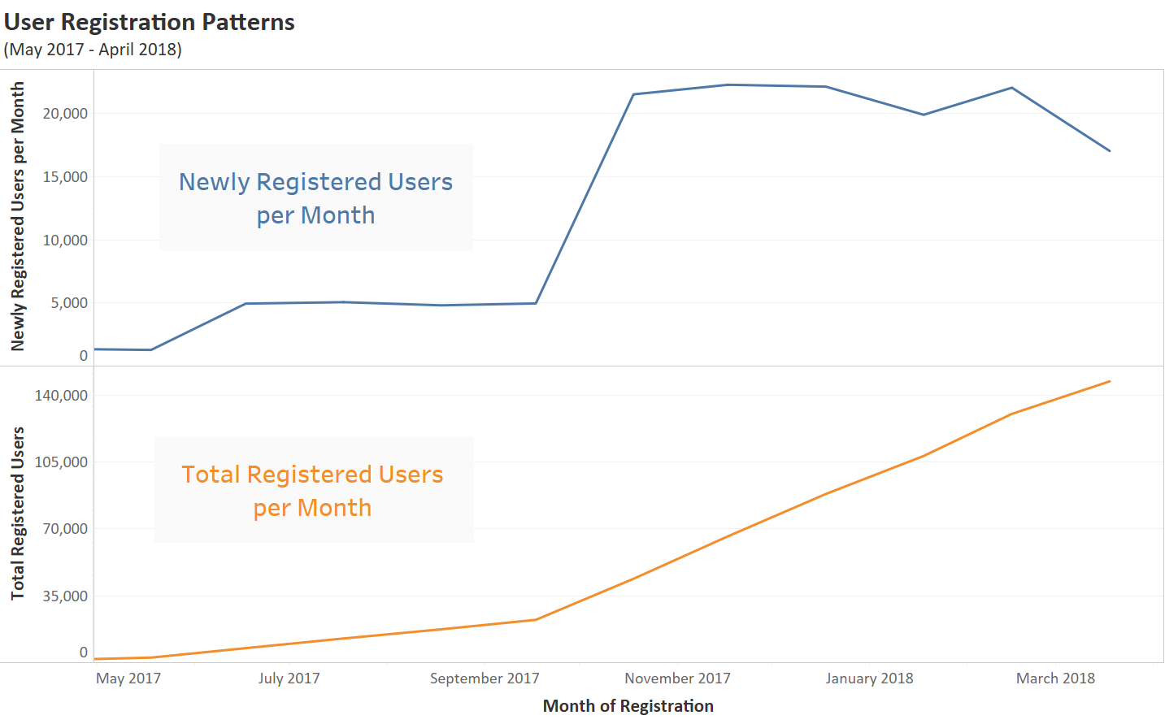
Adoption of Chaterly Most of the adopters of Chaterly registered from October 2017 onwards
Initial adoption of Chaterly was low.
16,500 increase in monthly registrations in October 2017.
Decrease in new monthly registrations from February 2018.

Slide 6
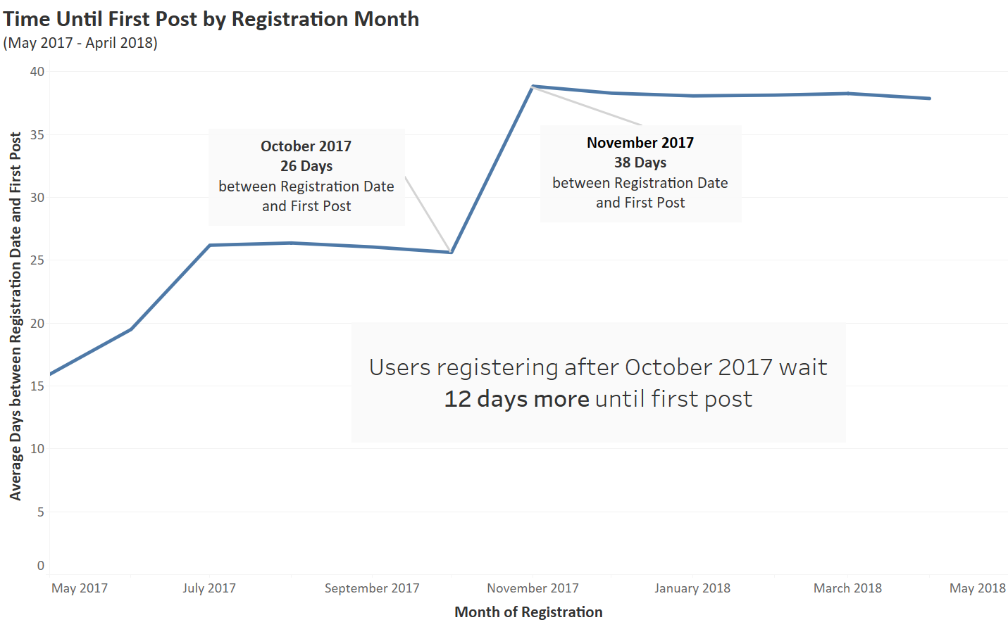
Usage Pattern Overall increasing time lag between registration and first usage of Chaterly
Users registering after October take more time to make their first post.
Users registered in the last 7 months wait 38 days before first post.
No decrease in time before first post since October 2017.

Slide 7
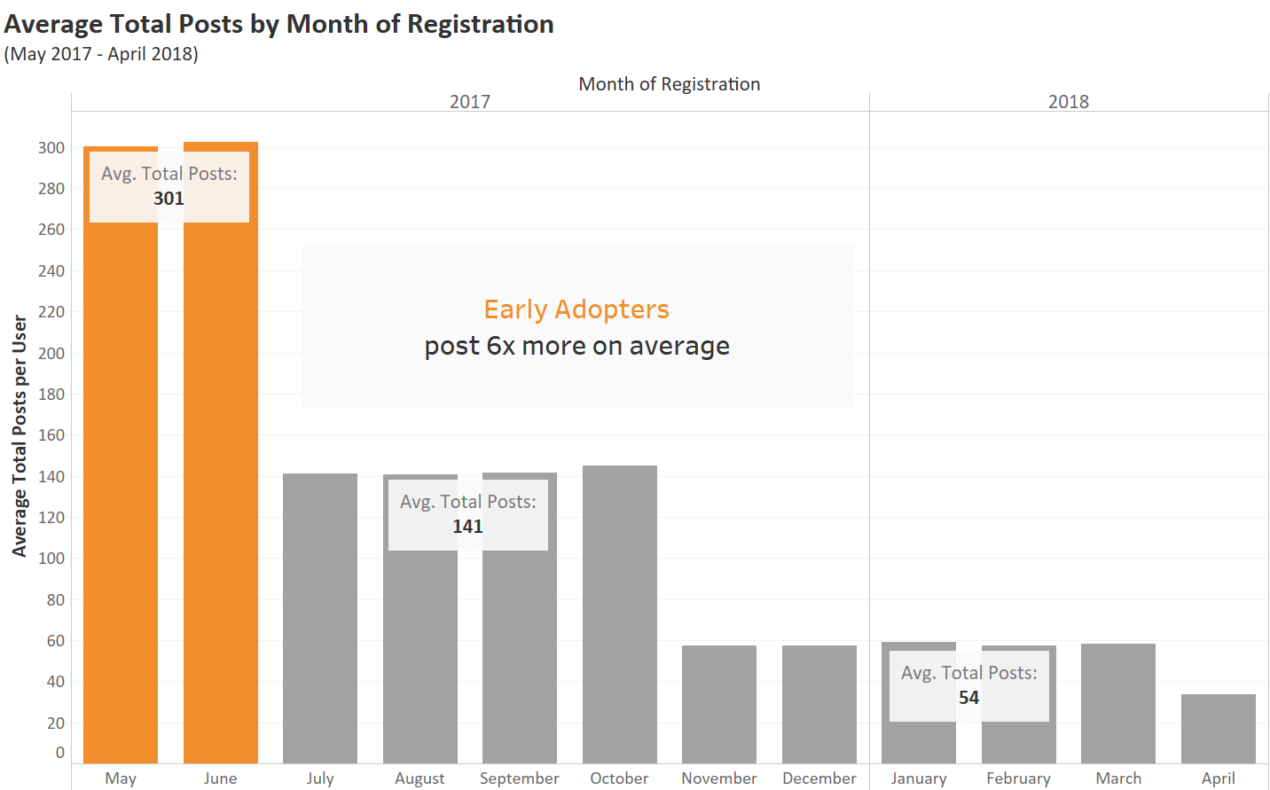
Usage Pattern Users who registered earlier, posted more on average compared to others
Early adopters posted 301 times on average.
Users that registered from July to October posted 141 times on average.
Users that registered in the last 6 months posted 54 times on average.

Slide 8
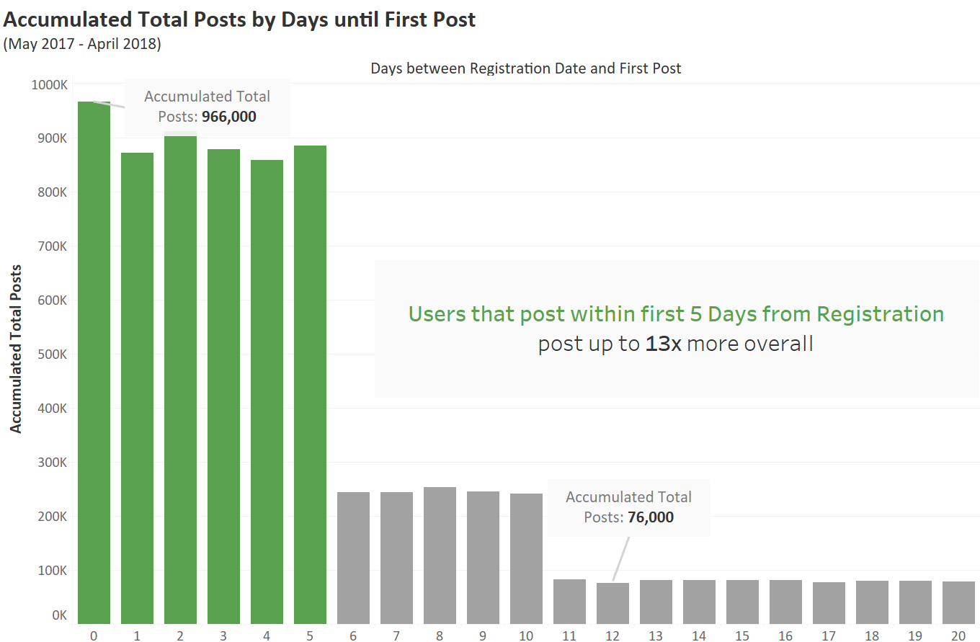
Usage Pattern Adopters who posted within the first 5 days, posted more often overall
Users that first posted on their day of registration posted 966,000 times in total.
The longer users wait to make an initial post, the less posts they accumulate over time.

Slide 9
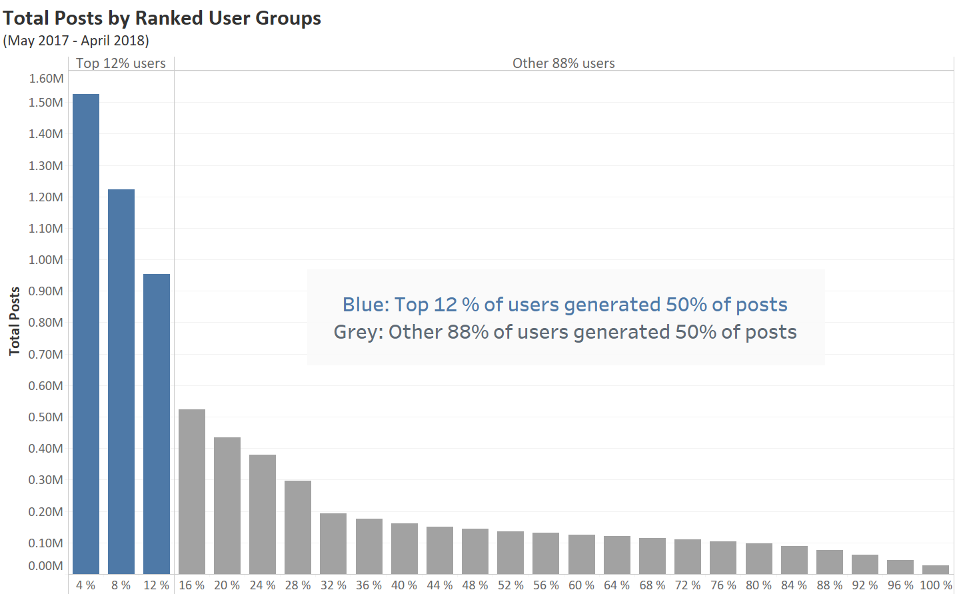
Upsell Opportunities 12% of users account for 50% of total posts (Power Users)

Slide 10
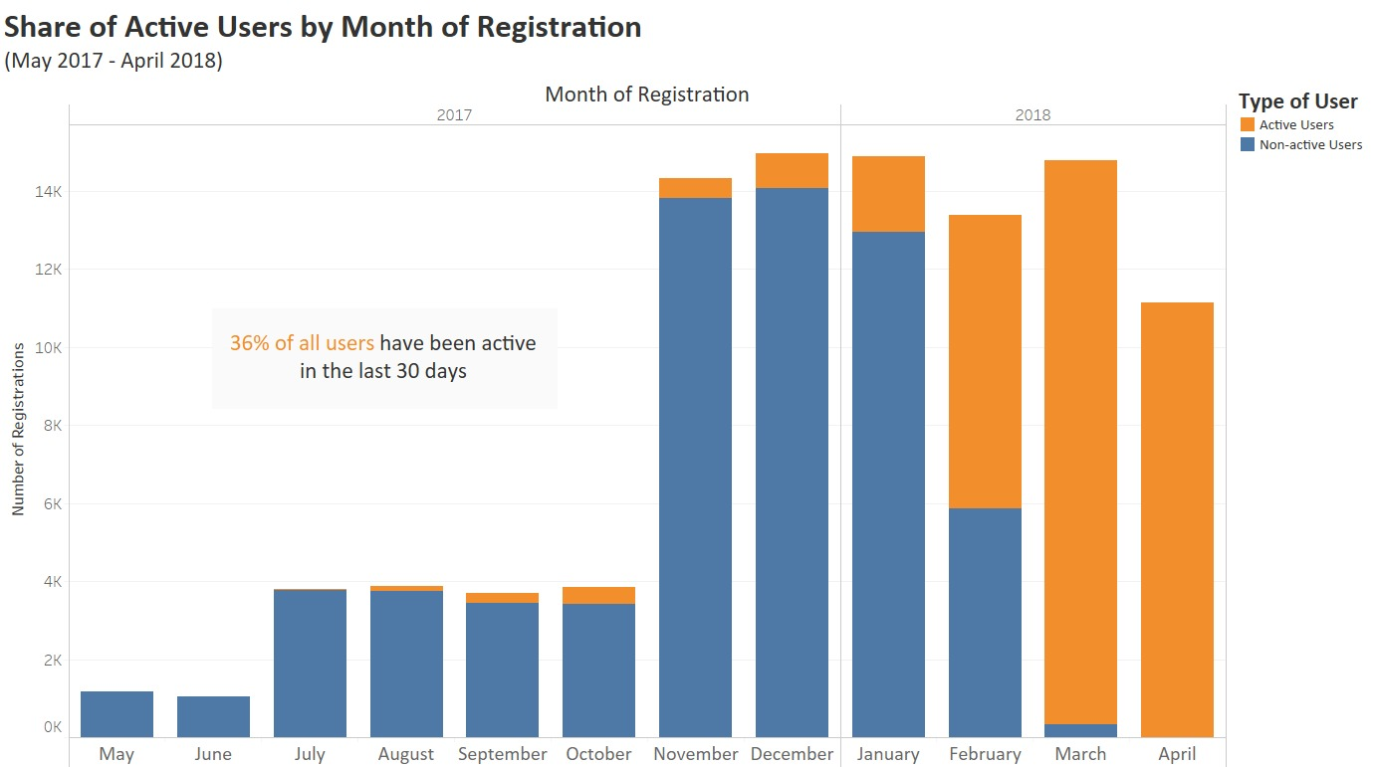
Upsell Opportunities Users that adopted Chaterly early on, don’t stay engaged on the platform
36% of all users have been active in the last 30 days.
None of the early adopters have contributed in the last 30 days.

Slide 11
Executive Summary
Adoption and Usage Patterns
Upsell Opportunities
101,000 out of 208,000 total employees have posted on Chaterly.
Early adopters (May – June 2017), used Chaterly 6x more than others.
Users that post within first 5 days after registration post 13x more in total.
12% of users generated 50% of the total posts (Power Users).
105% possible additional users. a
Incentivize early adoption to improve user interaction.
Incentivize quick activation to drive engagement.
Roll out Chaterly Pro to Active and Power Users.

Slide 12
Next steps Additional data is required to drive further business insights
Demographic Information
Does age affect the usage of Chaterly?
Professional Information
What department uses Chaterly the most? (Organisational data)
Do new hires engage more frequently on Chaterly? (Employee data)
Activity Frequency
What time do users post on Chaterly? (time stamps)
Who do they reach with their posts? (views, interactions by others)
Did the user upgrade to Chaterly Pro? (Yes/No)
What Pro features are used and when? (time stamps, interactions with others)

